Slide 1
FRAGMENTATION
The format and size of a frame depend on the protocol used by the physical network. A datagram may have to be fragmented to fit the protocol regulations.
The topics discussed in this section include:
Maximum Transfer Unit (MTU)
Fields Related to Fragmentation
TCP/IP Protocol Suite

Slide 2
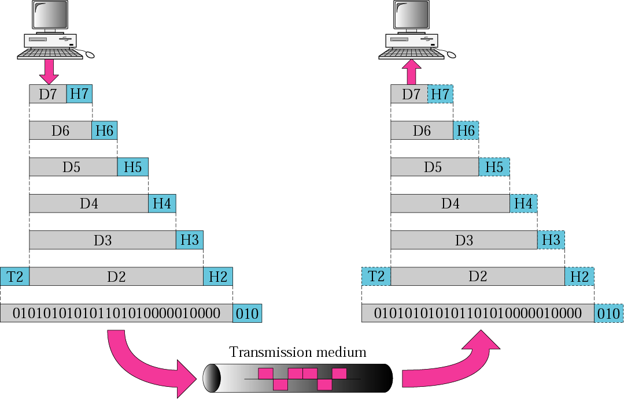
Fragmentation
A datagram can travel through different networks.
Each router decapsulates the IP datagram from the frame it receives, processes it, and then encapsulates it in another frame.
TCP/IP Protocol Suite

Slide 3
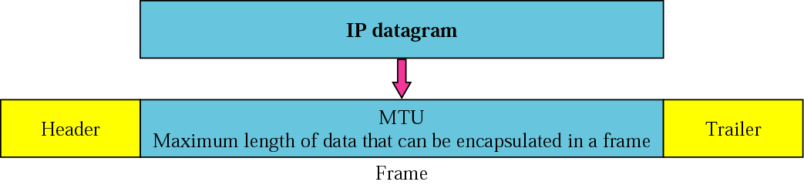
Maximum Transfer Unit (MTU)
Each data link layer protocol has its own frame format.
One of the fields defined in the format is the maximum size of the data field.
When a datagram is encapsulated in a frame, the total size of the datagram must be less than this maximum size.
TCP/IP Protocol Suite

Slide 4
MTU
Maximum Transfer Unit (MTU) (contd)
The value of the MTU differs from one physical network protocol to another.
For example, the value for the Ethernet LAN is 1500 bytes, for FDDI LAN is 4352 bytes, and for PPP is 296 bytes.
The maximum length of the IP datagram equal to 65,535 bytes.
We must divide the datagram to make it possible to pass through these networks. This is called fragmentation.
TCP/IP Protocol Suite
Notes:
Fiber Distributed Data Interface (FDDI)
Point-to-Point Protocol (PPP)

Slide 5
Maximum Transfer Unit (MTU) (contd)
When a datagram is fragmented, each fragment has its own header with most of the fields repeated, but some changed.
A fragmented datagram may itself be fragmented if it encounters a network with an even smaller MTU.
A datagram can be fragmented by any router in the path.
The reassembly of the datagram, is done only by the destination host.
TCP/IP Protocol Suite

Slide 6
Maximum Transfer Unit (MTU) (contd)
When a datagram is fragmented, required parts of the header must be copied by all fragments.
The host or router that fragments a datagram must change the values of three fields: flags, fragmentation offset, and total length.
The rest of the fields must be copied.
The value of the checksum must be recalculated regardless of fragmentation.
TCP/IP Protocol Suite

Slide 7
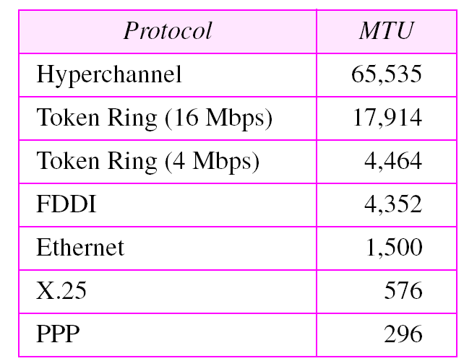
Table 8.5 MTUs for some networks
TCP/IP Protocol Suite

Slide 8
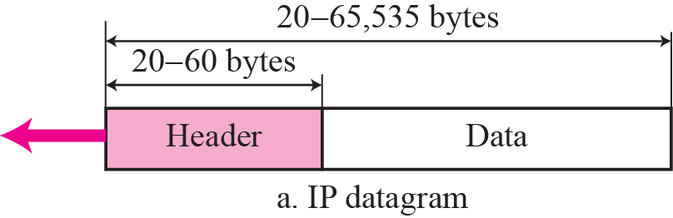
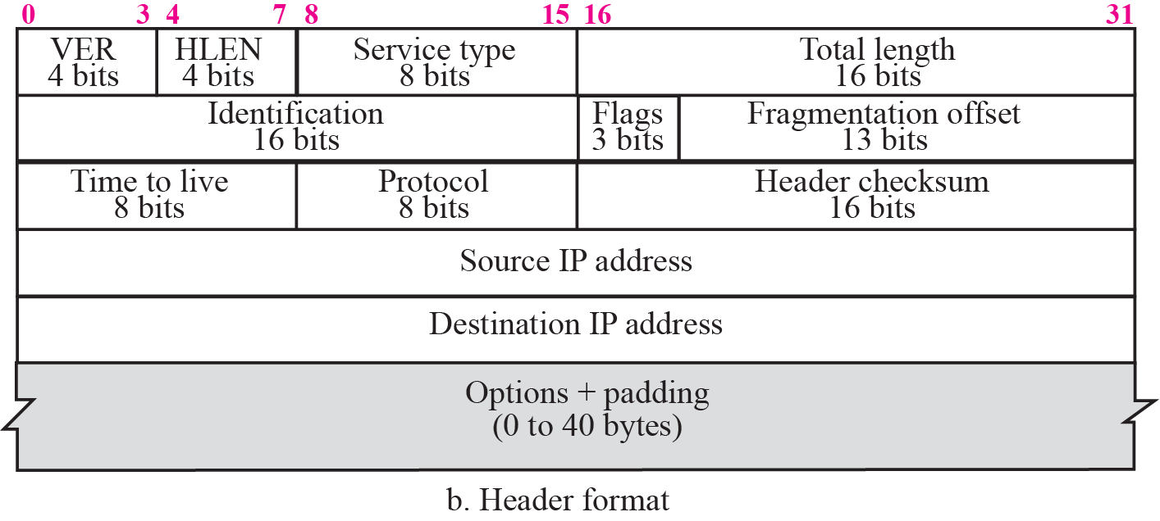
Fields Related to Fragmentation
TCP/IP Protocol Suite

Slide 9
Fields Related to Fragmentation
Fields related to fragmentation and reassembly of an IP datagram are the identification, flags, and fragmentation offset
Identification.
This 16-bit field identifies a datagram originating from the source host.
Combination of the identification and source IP address must uniquely define a datagram.
When a datagram is fragmented, the value in the identification field is copied into all fragments.
The identification number helps the destination in reassembling the datagram.
TCP/IP Protocol Suite

Slide 10
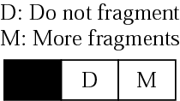
Flags
This is a three-bit field. The first bit is reserved (not used).
The second bit is called the do not fragment bit. If its value is 1, the machine must not fragment the datagram.
If it cannot pass the datagram through any available physical network, it discards the datagram and sends an ICMP error message to the source host. If its value is 0, the datagram can be fragmented if necessary.
The third bit is called the more fragment bit. If its value is 1, it means the datagram is not the last fragment; there are more fragments after this one. If its value is 0, it means this is the last or only fragment.
TCP/IP Protocol Suite

Slide 11
Fragmentation offset
This 13-bit field shows the relative position of this fragment with respect to the whole datagram.
It is the offset of the data in the original datagram measured in units of 8 bytes.
TCP/IP Protocol Suite

Slide 12
Fragmentation offset
Example: a datagram with a data size of 4000 bytes fragmented into three fragments.
The bytes in the original datagram are numbered 0 to 3999.
First fragment carries bytes 0 to 1399. Offset for this datagram is 0/8 = 0.
Second fragment carries bytes 1400 to 2799; offset for this fragment is 1400/8 = 175.
Third fragment carries bytes 2800 to 3999. Offset value for this fragment is 2800/8 = 350.
TCP/IP Protocol Suite

Slide 13
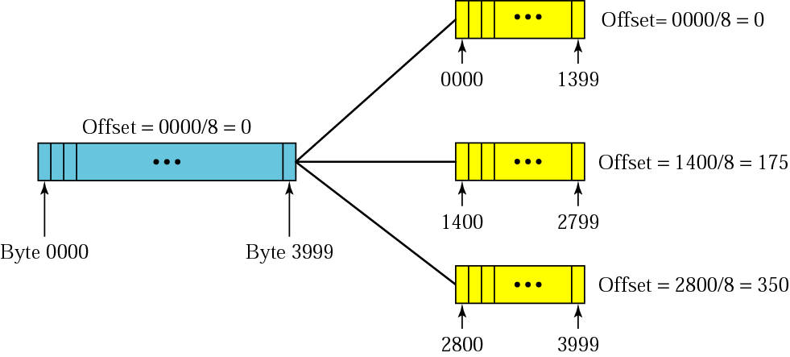
Fragmentation example
TCP/IP Protocol Suite

Slide 14
Fragmentation example
The offset is measured in units of 8 bytes because the length of the offset field is only 13 bits long and cannot represent a sequence of bytes greater than 8191.
TCP/IP Protocol Suite

Slide 15
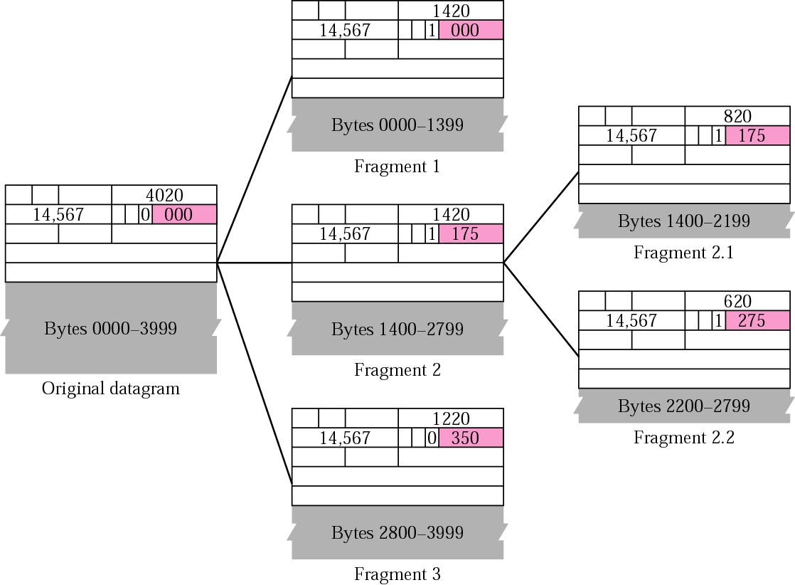
Expanded view of the fragments.
The value of the identification field is the same in all fragments.
The value of the flags field with the more bit set for all fragments except the last.
TCP/IP Protocol Suite
(1400+800)/2 = 275

Slide 16
Detailed fragmentation example
Even if each fragment follows a different path and arrives out of order, the final destination host can reassemble the original datagram from the fragments received (if none of them is lost) using the following strategy:
The first fragment has an offset field value of zero.
Divide the length of the first fragment by 8. The second fragment has an offset value equal to that result.
Divide the total length of the first and second fragment by 8. The third fragment has an offset value equal to that result.
Continue the process. The last fragment has a more bit value of 0
TCP/IP Protocol Suite

Slide 17
Example 5
A packet has arrived with an M bit value of 0.
Is this the first fragment, the last fragment, or a middle fragment?
Do we know if the packet was fragmented?
Solution
If the M bit is 0, it means that there are no more fragments; the fragment is the last one.
However, we cannot say if the original packet was fragmented or not. A nonfragmented packet is considered the last fragment.
TCP/IP Protocol Suite

Slide 18
Example 6
A packet has arrived with an M bit value of 1.
Is this the first fragment, the last fragment, or a middle fragment?
Do we know if the packet was fragmented?
Solution
If the M bit is 1, it means that there is at least one more fragment. This fragment can be the first one or a middle one, but not the last one.
We don’t know if it is the first one or a middle one; we need more information (the value of the fragmentation offset).
TCP/IP Protocol Suite

Slide 19
Example 7
A packet has arrived with an M bit value of 1 and a fragmentation offset value of zero.
Is this the first fragment, the last fragment, or a middle fragment?.
Solution
Because the M bit is 1, it is either the first fragment or a middle one. Because the offset value is 0, it is the first fragment.
TCP/IP Protocol Suite

Slide 20
Example 8
A packet has arrived in which the offset value is 100. What is the number of the first byte? Do we know the number of the last byte?
Solution
To find the number of the first byte, we multiply the offset value by 8. This means that the first byte number is 800.
We cannot determine the number of the last byte unless we know the length of the data.
TCP/IP Protocol Suite

Slide 21
Example 9
A packet has arrived in which the offset value is 100, the value of HLEN is 5 and the value of the total length field is 100.
What is the number of the first byte and the last byte?
Solution
The first byte number is 100 × 8 = 800. The total length is 100 bytes and the header length is 20 bytes (5 × 4), which means that there are 80 bytes in this datagram. If the first byte number is 800, the last byte number must be 879.
TCP/IP Protocol Suite

Slide 22
Suppose 1MByte of application data (including application layer header) has to be sent out of a host attached to Ethernet. Assume the application uses TCP protocol and that the IP as well as TCP header is 20 bytes each. Further assume that Ethernet MTU size is 1500.
How many datagrams are sent out of the host?
TCP/IP Protocol Suite

Slide 23
Ans. 675
Since we are using Ethernet, the MTU size is 1500. Of this 20 bytes will go to the IP headers. So, each datagram carries 1480 bytes (application data +TCP header). So, the number of datagrams is ceil((10^6+20)/1480) = 675.
TCP/IP Protocol Suite

Slide 24
What is the size (in bytes) of the last datagram? Express answer in bytes.
ans. 1020 data+20 IP header=1040
1000020 – (1480 *675) = 1020
TCP/IP Protocol Suite

Slide 25
Suppose a TCP message of 2000 bytes of data and 20 bytes of TCP header is passed to the IP layer. Suppose this host is connected to a link with an MTU size of 512 Bytes. Assume header size of IP is 20 bytes.
What is the total length of the last IP fragment? Express in bytes.
TCP/IP Protocol Suite

Slide 26
Ans. 88
Total payload to the IP layer is 2020 bytes.
The MTU size is 512, out of which payload size is only 492. Since 492 is not a multiple of 8, payload is 488.
2020 bytes of data has to be distributed over 5 fragments, where the first 4 carry 488 bytes and the last carries the remaining 68.
Total length of the last fragment is 68+20 = 88
TCP/IP Protocol Suite

Slide 27
What is the value of the offset field in the last fragment? Format X (e.g. 136)
ans. 244
TCP/IP Protocol Suite

Slide 28
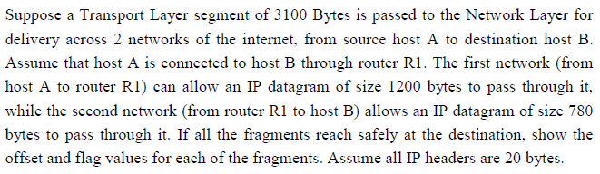
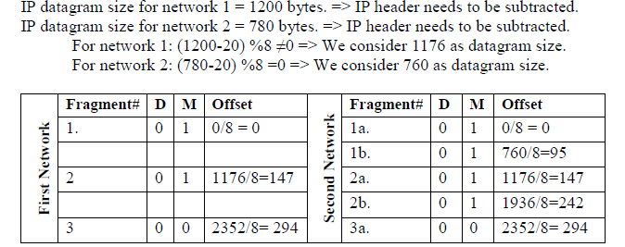
TCP/IP Protocol Suite

Slide 29

Suppose a Transport Layer segment of 8000 Bytes is passed to the Network Layer for delivery across 2 networks of the internet, from source host A to destination host B. Assume that host A is connected to host B through router R1. The first network (from host A to router R1) can allow an IP datagram of size 3000 bytes to pass through it, while the second network (from router R1 to host B) allows an IP datagram of size 1800 bytes to pass through it. If all the fragments reach safely at the destination, show the offset and flag values for each of the fragments. Assume all IP headers are 20 bytes.(
TCP/IP Protocol Suite

Slide 30
OPTIONS
TCP/IP Protocol Suite

Slide 31
TCP/IP Protocol Suite
Notes:
Class – general purpose of the option
Number defines the type of option.

Slide 32
OPTIONS
Options are not required for a datagram.
They can be used for network testing and debugging.
TCP/IP Protocol Suite
Notes:
Class – general purpose of the option
Number defines the type of option.

Slide 33
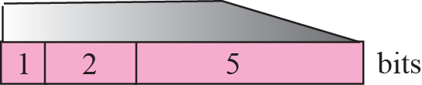
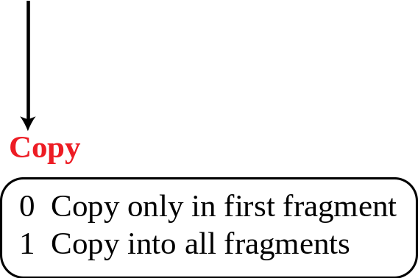
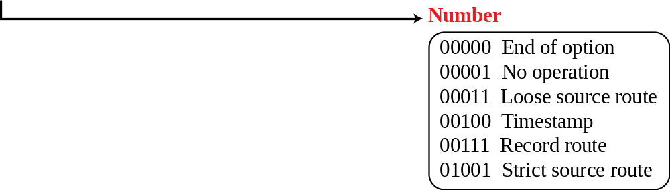
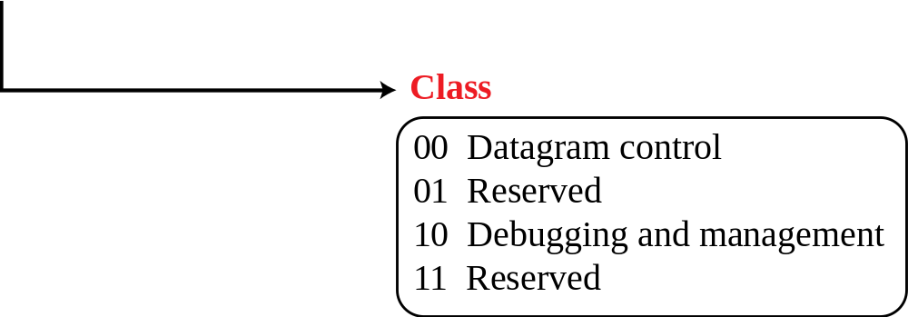
Figure 7.10 Option format
Composed of a 1-byte type field, a 1-byte length field, and a variable-sized value field.
The three fields are often referred to as type-length-value or TLV.
TCP/IP Protocol Suite

Slide 34
Type
Contains 3 subfields: copy, class, and number.
Copy.
Controls the presence of the option in fragmentation.
0 -> The option must be copied only to the first fragment.
1 -> The option must be copied to all fragments.
Class.
Defines the general purpose of the option.
00 -> the option is used for datagram control.
10 -> the option is used for debugging and management.
Number.
Defines the type of option.
Currently only 6 types are in use.
TCP/IP Protocol Suite
Notes:
Class – general purpose of the option
Number defines the type of option.

Slide 35
Length
Defines the total length of the option including the type field and the length field itself.
This field is not present in all of the option types.
Value
The value field contains the data that specific options require.
This field is also not present in all option types
TCP/IP Protocol Suite
Notes:
Class – general purpose of the option
Number defines the type of option.

Slide 36
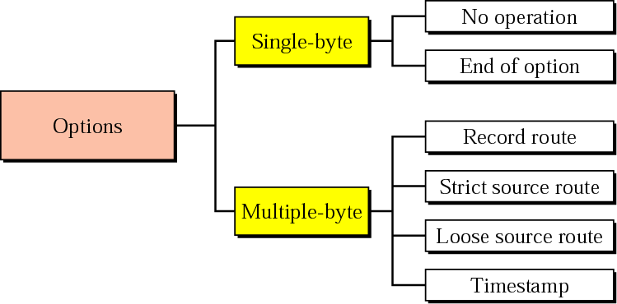
Option Types
Two of these are 1-byte options, and they do not require the length or the data fields.
Four of them are multiple-byte options; they require the length and the data fields .
TCP/IP Protocol Suite
Notes:
Class – general purpose of the option
Number defines the type of option.

Slide 37
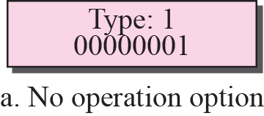
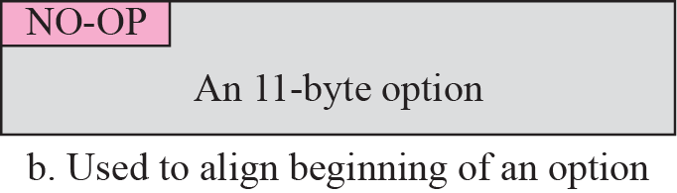
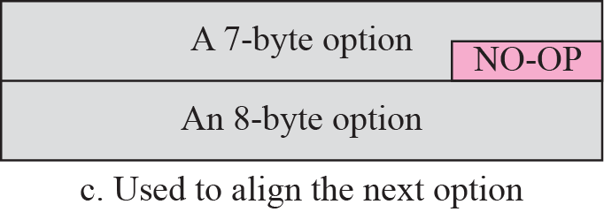
No operation option
No-Operation Option
Used as a filler between options.
Used to align the next option on a 16-bit or 32-bit boundary.
TCP/IP Protocol Suite
Notes:
A no-operation option is a 1-byte option used as a filler between options. For example,
it can be used to align the next option on a 16-bit or 32-bit boundary

Slide 38
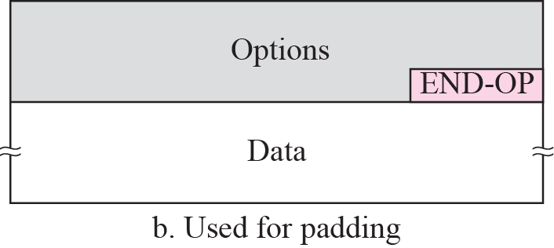
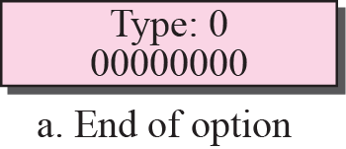
End –of- option option
End-of-Option Option
Used for padding at the end of the option field.
Can only be used as the last option.
Only one end-of-option option can be used. After this option, the receiver looks for the payload data.
This means that if more than 1 byte is needed to align the option field, some no-operation options must be used, followed by an end-of-option option.
TCP/IP Protocol Suite
Notes:
An end-of-option option is also a 1-byte option used for padding at the end of the
option field. It, however, can only be used as the last option.

Slide 39
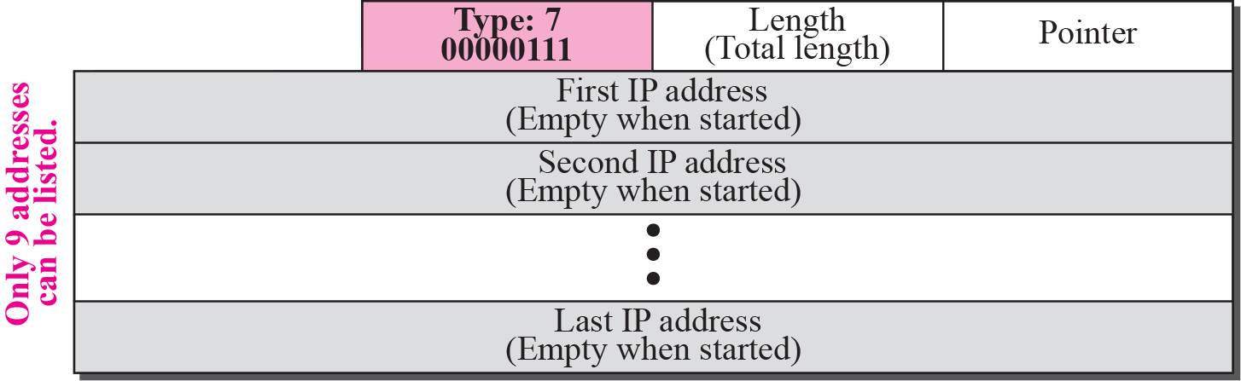
Record-Route Option
It can list up to 9 router IP addresses.
Source creates placeholder fields in the option to be filled by the visited routers.
TCP/IP Protocol Suite

Slide 40
Record-Route Option
The pointer field is an offset integer field containing the byte number of the first empty entry.
It points to the first available entry.
The source creates empty fields for the IP addresses in the data field of the option.
The pointer field has a value of 4, pointing to the first empty field.
TCP/IP Protocol Suite
Notes:
A record-route option is used to record the Internet routers that handle the datagram.
List upto 9 routers
40 bytes ; 8+8=16 bit code and len balance is 38 byte.
Ip address 4 byte, max possible is 9*4 =36 byte.
Pointer

Slide 41
Record-Route Option
When the datagram is traveling, each router that processes the datagram compares the value of the pointer with the value of the length.
If the value of the pointer is greater than the value of the length, the option is full and no changes are made.
If the value of the pointer is not greater than the value of the length, the router inserts its outgoing IP address in the next empty field.
The router then increments the value of the pointer by 4.
TCP/IP Protocol Suite
Notes:
A record-route option is used to record the Internet routers that handle the datagram.
List upto 9 routers
40 bytes ; 8+8=16 bit code and len balance is 38 byte.
Ip address 4 byte, max possible is 9*4 =36 byte.
Pointer

Slide 42
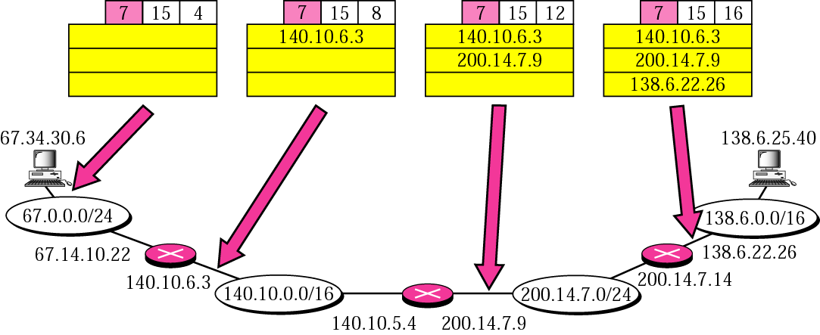
Record-Route Option
TCP/IP Protocol Suite

Slide 43
Strict source route option
used by the source to predetermine a route for the datagram as it travels through the Internet.
a sender can choose a route so that its datagram does not travel through a competitor’s network.
If a datagram specifies a strict source route, all of the routers defined in the option must be visited by the datagram.
Regular users of the Internet, however, are not usually aware of the physical topology of the Internet.
Strict source routing is not the choice of most users.
TCP/IP Protocol Suite
Notes:
A strict-source-route option is used by the source to predetermine a route for the datagram
as it travels through the Internet. The sender can choose a route with a specific type of service, such
as minimum delay or maximum throughput. Alternatively, it may choose a route that is
safer or more reliable for the sender’s purpose.

Slide 44
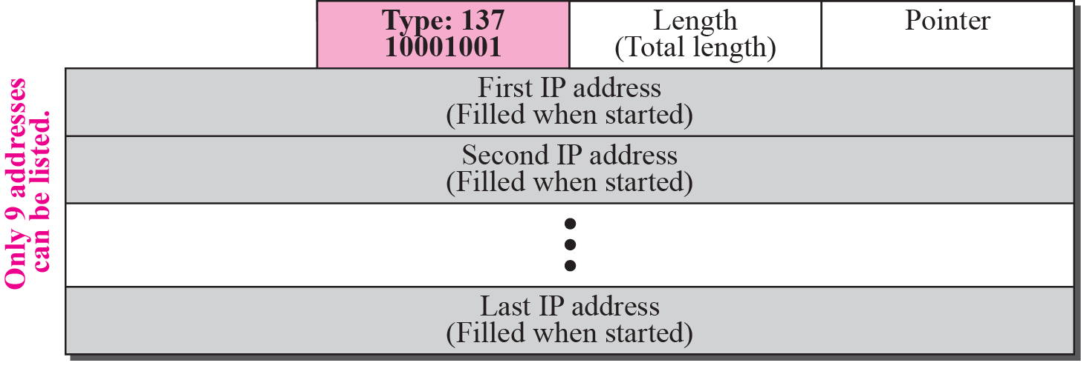
Strict source route option
The format is similar to the record route option with the exception that all of the IP addresses are entered by the sender.
TCP/IP Protocol Suite
Notes:
A strict-source-route option is used by the source to predetermine a route for the datagram
as it travels through the Internet. The sender can choose a route with a specific type of service, such
as minimum delay or maximum throughput. Alternatively, it may choose a route that is
safer or more reliable for the sender’s purpose.

Slide 45
Strict source route option
When the datagram is traveling, each router that processes the datagram compares the value of the pointer with the value of the length.
If the value of the pointer is greater than the value of the length, the datagram has visited all of the predefined routers.
If the value of the pointer is not greater than the value of the length, the router compares the destination IP address with its incoming IP address: If they are equal, it processes the datagram, swaps the IP address pointed by the pointer with the destination address, increments the pointer value by 4, and forwards the datagram.
If they are not equal, it discards the datagram and issues an error message.
TCP/IP Protocol Suite
Notes:
A strict-source-route option is used by the source to predetermine a route for the datagram
as it travels through the Internet. The sender can choose a route with a specific type of service, such
as minimum delay or maximum throughput. Alternatively, it may choose a route that is
safer or more reliable for the sender’s purpose.

Slide 46
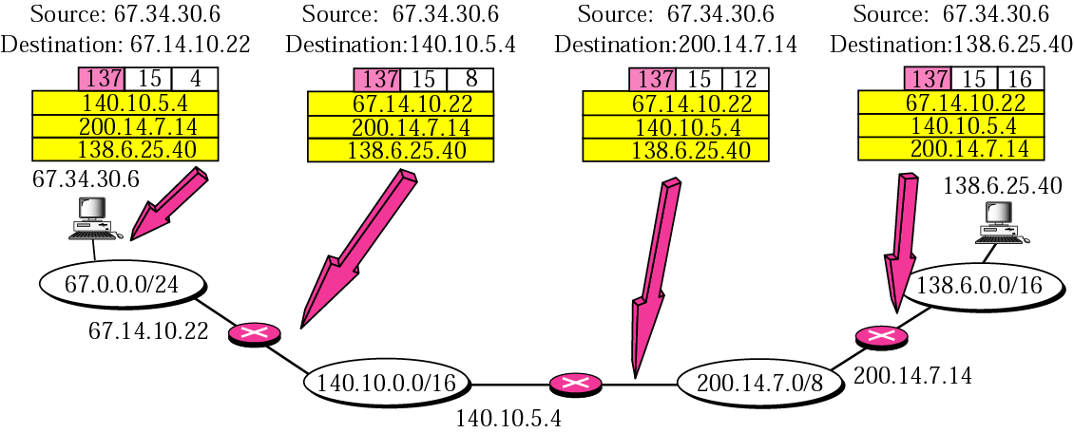
Strict source route concept
TCP/IP Protocol Suite
Notes:
Used by source to predetermine the route traversed by the datagram:
Minimium delay, maximum throughput, competitior network

Slide 47
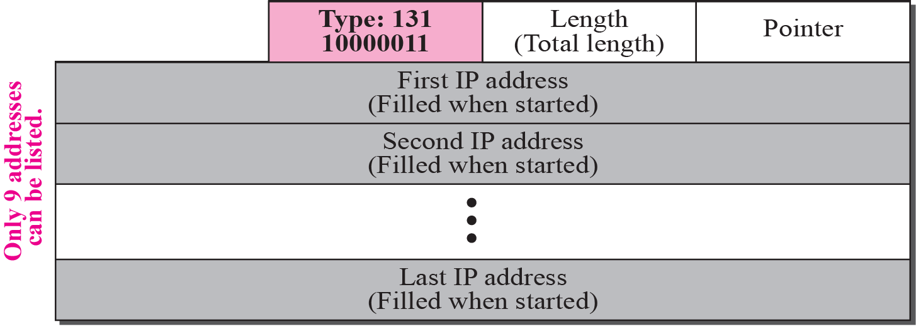
Loose source route option
A loose-source-route option is similar to the strict source route, but it is more relaxed.
Each router in the list must be visited, but the datagram can visit other routers as well.
TCP/IP Protocol Suite

Slide 48
Timestamp option
Used to record the time of datagram processing by a router.
Help users and managers track the behavior of the routers in the Internet.
We can estimate the time it takes for a datagram to go from one router to another.
Nonprivileged users of the Internet are not usually aware of the physical topology of the Internet.
Timestamp option is not a choice for most users.
TCP/IP Protocol Suite
Notes:
A timestamp option is used to record the time of datagram processing by a router. The overflow field records the number of routers that could not add their timestamp
because no more fields were available. The flags field specifies the visited router
responsibilities.

Slide 49
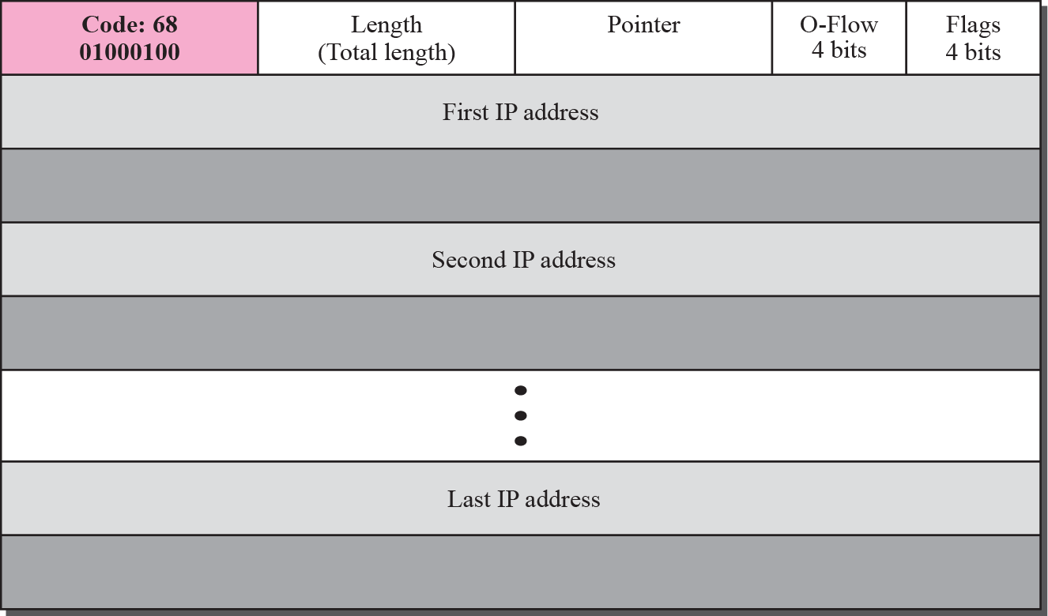
Timestamp option
TCP/IP Protocol Suite
Notes:
A timestamp option is used to record the time of datagram processing by a router. The overflow field records the number of routers that could not add their timestamp
because no more fields were available. The flags field specifies the visited router
responsibilities.

Slide 50
Timestamp option
The overflow field records the number of routers that could not add their timestamp because no more fields were available.
The flags field specifies the visited router responsibilities.
0 -> each router adds only the timestamp in the provided field.
1-> each router must add its outgoing IP address and the timestamp.
3 -> the IP addresses are given, and each router must check the given IP address with its own incoming IP address.
TCP/IP Protocol Suite
Notes:
A timestamp option is used to record the time of datagram processing by a router. The overflow field records the number of routers that could not add their timestamp
because no more fields were available. The flags field specifies the visited router
responsibilities.

Slide 51
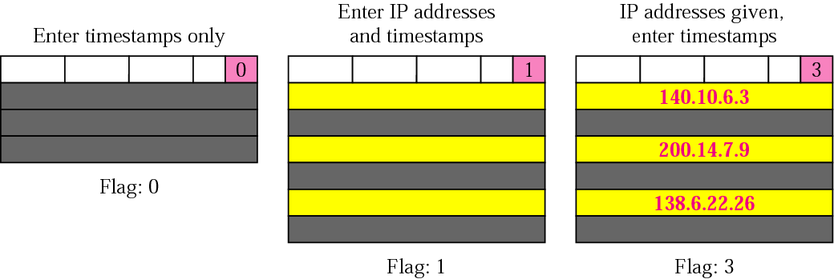
Use of flag in timestamp
TCP/IP Protocol Suite

Slide 52
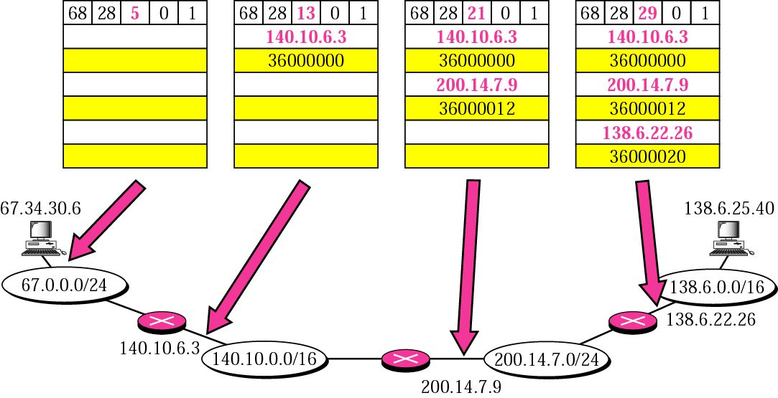
Timestamp concept
Figure shows the actions taken by each router when a datagram travels from source to destination. ( assumes a flag value of 1).
TCP/IP Protocol Suite

Slide 53
Example 10
Which of the six options must be copied to each fragment?
a. No operation: Code is 00000001;
b. End of option: Code is 00000000;
c. Record route: Code is 00000111;
d. Strict source route: Code is 10001001;
e. Loose source route: Code is 10000011;
f. Timestamp: Code is 01000100;
TCP/IP Protocol Suite

Slide 54
Example 10
Which of the six options must be copied to each fragment?
Solution
We look at the first (left-most) bit of the code for each option.
a. No operation: Code is 00000001; not copied.
b. End of option: Code is 00000000; not copied.
c. Record route: Code is 00000111; not copied.
d. Strict source route: Code is 10001001; copied.
e. Loose source route: Code is 10000011; copied.
f. Timestamp: Code is 01000100; not copied.
TCP/IP Protocol Suite

Slide 55
Example 11
Which of the six options are used for datagram control and which are used for debugging and management?
a. No operation: Code is 00000001;.
b. End of option: Code is 00000000;.
c. Record route: Code is 00000111;.
d. Strict source route: Code is 10001001;.
e. Loose source route: Code is 10000011;.
f. Time stamp: Code is 01000100;
control.
TCP/IP Protocol Suite

Slide 56
Example 11
Which of the six options are used for datagram control and which are used for debugging and management?
Solution
We look at the second and third (left-most) bits of the code.
a. No operation: Code is 00000001; datagram control.
b. End of option: Code is 00000000; datagram control.
c. Record route: Code is 00000111; datagram control.
d. Strict source route: Code is 10001001; datagram control.
e. Loose source route: Code is 10000011; datagram control.
f. Time stamp: Code is 01000100; debugging and management
control.
TCP/IP Protocol Suite

Slide 57
TCP/IP Protocol Suite

